Slide 1
Selenium Course Session 4

Slide 2
Objective
Drop Down
Alert/Popup
iFrame
Keyboard Event
Mouse Hover
Scroll Up/Down

Slide 3
Drop Down
Values of dropdown are generally saved on <Select> tag.
The 'Select' class in Selenium WebDriver is used for selecting and deselecting option in a dropdown.
The objects of Select type can be initialized by passing the dropdown WebElement as parameter to its constructor.
Select sel = new Select(WebElement Locator);
sel.selectByVisibleText("dropdown value")

Slide 4
Alert/Popup
Alert is a small message box which displays on-screen notification to give the user some kind of information or ask for permission to perform certain kind of operation. It may be also used for warning purpose.
Link: https://mail.rediff.com/cgi-bin/login.cgi

Slide 5
Handling Alert/Popup..
To click on the 'Cancel' button: driver.switchTo().alert().dismiss();
To click on the 'OK' button: driver.switchTo().alert().accept();
To capture the alert message: driver.switchTo().alert().getText();
To send some data to alert box: driver.switchTo().alert().sendKeys("Text");

Slide 6
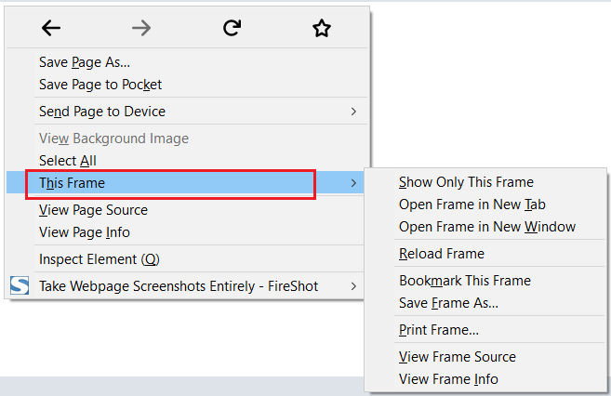
iFrame
IFrame is a web page which is embedded in another web page or an HTML document embedded inside another HTML document.
3 ways to identify:
It can be identified in the Firefox browser if the option named ‘This frame’ is displayed on the right-click options
By inspecting the source code and searching for the tag <iframe> or <frameset>
By using the following code: driver.findElements(By.tagName("iframe")).size();
Link: https://docs.oracle.com/javase/8/docs/api/

Slide 7
Handling iFrame..
3 ways to switch between frames:
By Index:
driver.switchTo().frame(0);
By Name or Id:
driver.switchTo().frame(“name of the element");
driver.switchTo().frame("id of the element");
By Web Element:
driver.switchTo().frame(WebElement);
2 ways to get back to main/default frame:
driver.switchTo().parentFrame();
driver.switchTo().defaultContent();

Slide 8
Keyboard Event
Keyboard events generate by pressing a key or a combination of keys on a keyboard.
In order to press a keyboard key Action class is required.
Actions action = new Actions(driver);
action.sendKeys(Keys.ENTER).build().perform();

Slide 9
Mouse Hover
It’s an action in selenium to perform mouse hover over an element.
Actions class is required to perform mouse hover.
Actions action = new Actions(driver);
action.moveToElement(driver.findElement(By.xpath(" "))).build().perform();
Link: https://www.dell.com/en-us

Slide 10
Other Operations..
action.clickAndHold() - Click (without releasing) at the current mouse location.
action.doubleClick() - Performs a double-click at the current mouse location.
action.dragAndDrop(source, target) - Performs click-and-hold at the location of the source element, moves to the location of the target element, then releases the mouse.
action.dragAndDropBy(source, x-offset, y-offset) - Performs click-and-hold at the location of the source element, moves by a given offset, then releases the mouse.
action.moveToElement(toElement) - Moves the mouse to the middle of the element.
action.release() - Releases the depressed left mouse button at the current mouse location

Slide 11
Scroll Up/Down
It is used to move the window up and down.
It uses Use JavascriptExecutor
JavaScriptExecutor is an Interface that helps to execute JavaScript through Selenium Webdriver.
JavascriptExecutor js = (JavascriptExecutor) driver;
//vertically scroll by 200 pixels
js.executeScript("scroll(0,200)");
or js.executeScript("window.scrollBy(0,200)");

Slide 12
Interview Questions
Which class do you need to deal with Alert/Popup?
How to deal with iFrame?
How do you Hover Over mouse?
How do deal with Scroll Up/Down?
How to switch driver to a New Window?
How to pass Keyboard Keys?

Slide 13
Home Work
Automate the following test case:
Scenario: CRM -> Customers -> Add Contact - Add contact and validate contact added in List Contacts
Open Browser and go to site http://techfios.com/test/billing/?ng=admin/
Enter username: demo@techfios.com
Enter password: abc123
Click login button
Click on Customers button in the Side Navigation
Click on Add Customer
Fill in the Add Customer Form
Click submit
Go to CRM -> List Customer Page
Search for the new Customer in the search field
Validate contact Customer ​

